Slide 1

Weekly Report
Tianyu Wang
July 28,2021

Slide 2

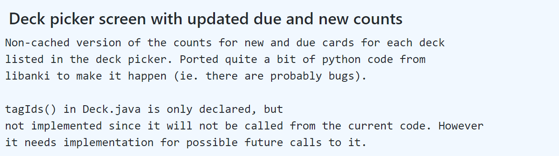
Task 1: commit message collection
2 parts of commit message were collected(title and body)using the commands below
Commit title
Commit body
git log --pretty=format:”%s” SHA -1
git log --pretty=format:”%b” SHA -1
Status: all data has been collected and will do data cleaning if needed.

Slide 3
Task 2: code comment collection
Use regular expression to get single line comments and multi line comments.
/\*+[\s\S]*?\*+/
//.*(?<!;)[\n]
Status:
all data has been collected and will do data cleaning if needed.
3% clone pairs report error.

Slide 4
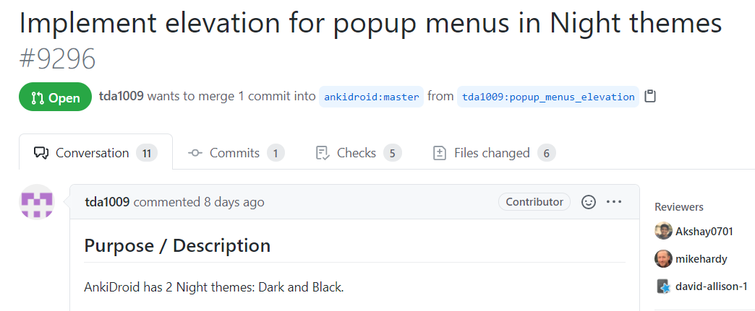
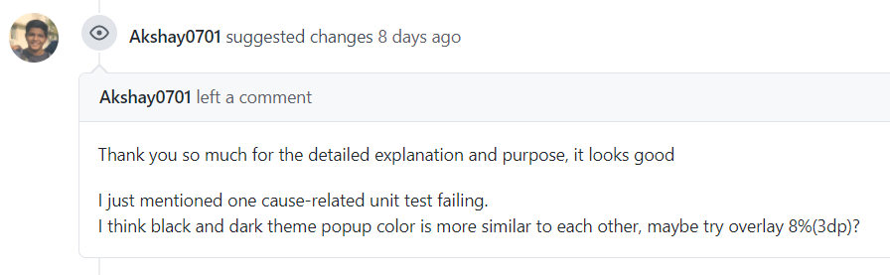
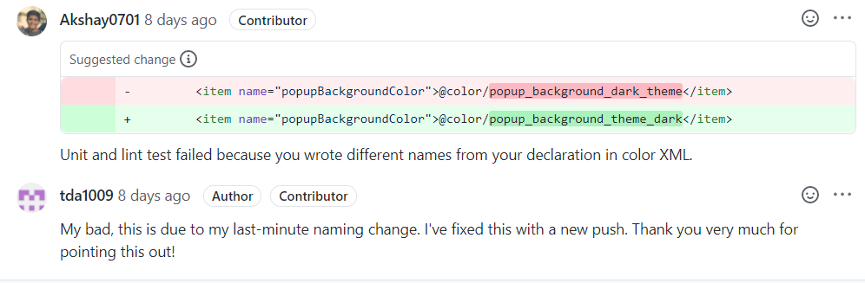
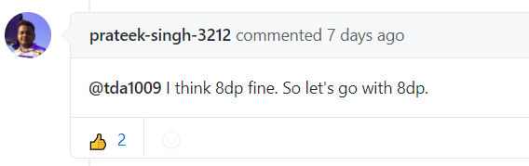
Task 3: pull request collection
5 types of commit message were collected using Github API.
title
reviews
body
review comments
Issue comments
Status:
The program is still running due to the speed limit of API

